Slide 1

The Hackerbots - Club 101
Hustle n’ code South LA Hackathon

Slide 2
The Problem
Our Solution
Transportation
Traffic
Pollution
Empty cars
Early mornings
Student safety

Slide 3
What it is:
Why it helps:
A carpooling app for students.
Parents register as drivers and create rides students can join.
Creates solidarity and bonding within the community.
Shared cars = less cars = less traffic and pollution
Parents help each other for free = solidarity
Driven to school = safety
Socializing

Slide 4
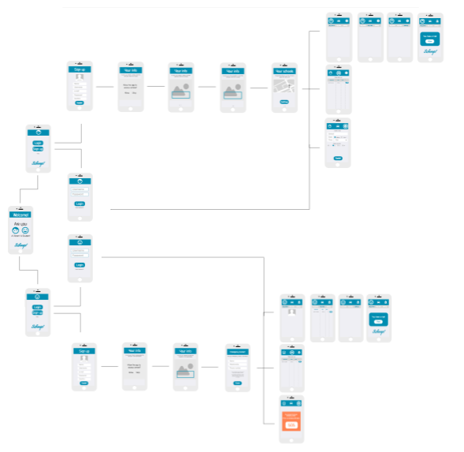
Storyboard

Slide 5
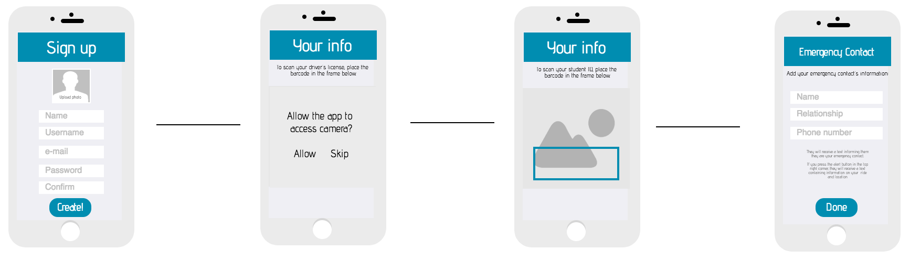
Student sign-up

Slide 6
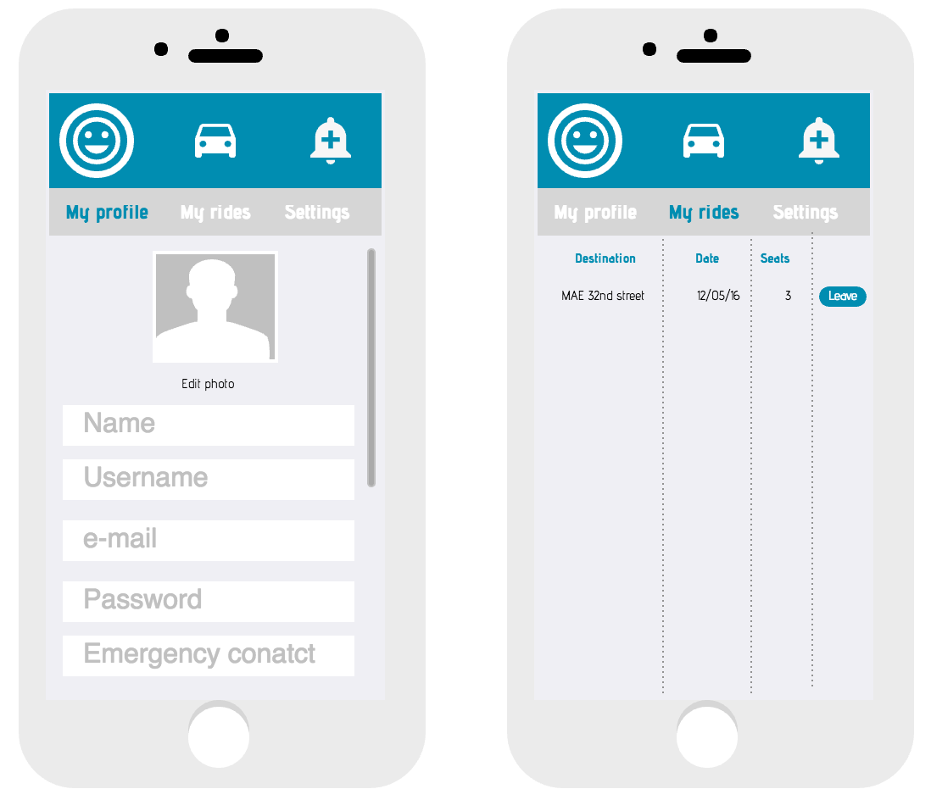
Features
Manage rides
Students and Parents can easily manage their information and rides via an intuitive User Interface.

Slide 7
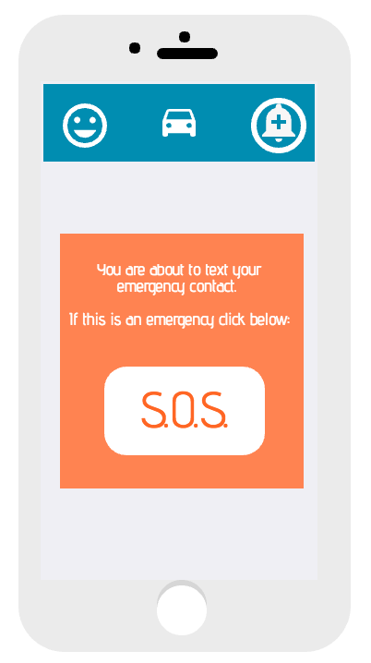
Features
Emergency button
Because safety is the main concern, students can pick an emergency contact. If for any reason they have a problem, they can press the alert button and the app will send a text to their emergency contact.
The text would contain information about the ride (driver, car, license plate, destination) and the student’s location.

Slide 8
Check-out our work so far on our computers!

